Slide 1
Binary Space Partitions
THE PAINTER’S ALGORITHM

Slide 2
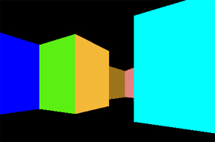

DOOM was developed in 1990 and the QUAKE jumped the band wagon.

Slide 3
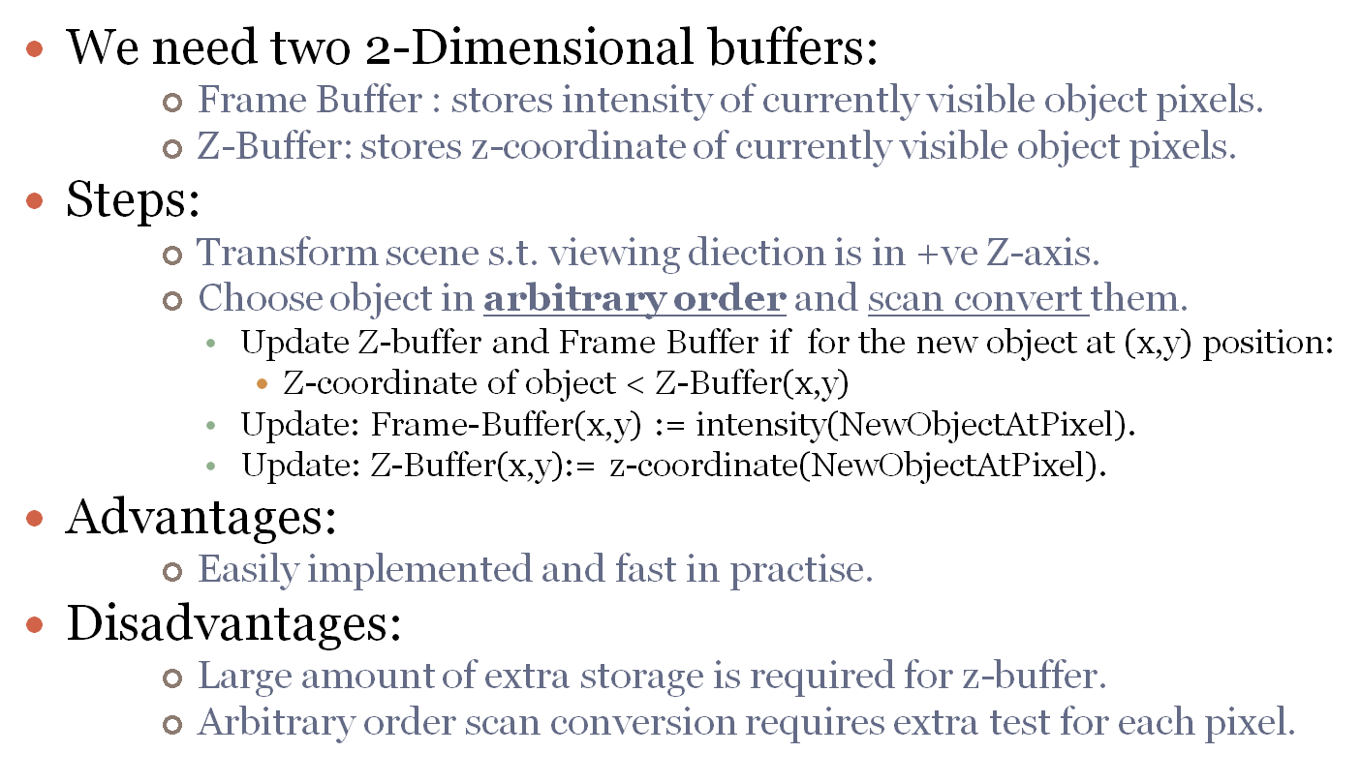
Z-Buffer Algorithm

Slide 4


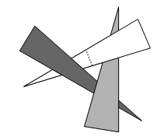
Painter’s Algorithm
Draw objects in Depth-order, i.e. from back to front.
We must be able to sort objects quickly.
Sorting is not fast, even worse: Order may not exist.
Hidden surface removal is needed.

Slide 5
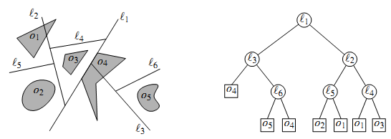
BSP Tree
Solution: Break the cycle by splitting.
But: Splitting point changes whenever
viewpoint changes. ☹
We need to preprocess scene s.t. correct displaying order can be found.
BSP Tree:

Slide 6
BSP Tree Background
For a d-dimensional space the splitting hyperplane equation:
Let h⁺ be open +ve half-space bounded by h.
Let be open –ve half-space bounded by h.

Slide 7
BSP Tree: Definition
BSP Tree T for set S of objects in d-dimensional space:
  If Cardinality(S) <= 1
    T is a leaf, object fragment is stored here.
    If it is denoted by v, S(v) is the set stored at the leaf.
  If Cardinality(S) > 1
    Root v of T stores hyper-plane h(v) with objects contained in h(v).
    LeftChild(v) :=
    RightChild(v):=

Slide 8
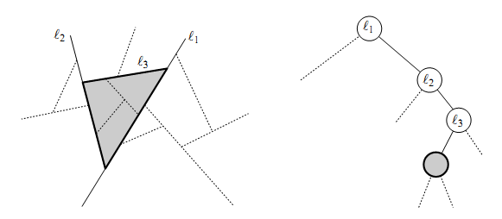
Correspondence between Nodes & Regions
leaves in a BSP tree represent the faces in the subdivision that the BSP induces.

Slide 9
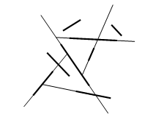
Auto-Partition
Splitting hyper-planes can be arbitrary.
When set of extension of input segments
are used in Auto-partitioning.
Auto-partitioning does not produce optimal partitioning.
Often produces small BSP trees.

Slide 10
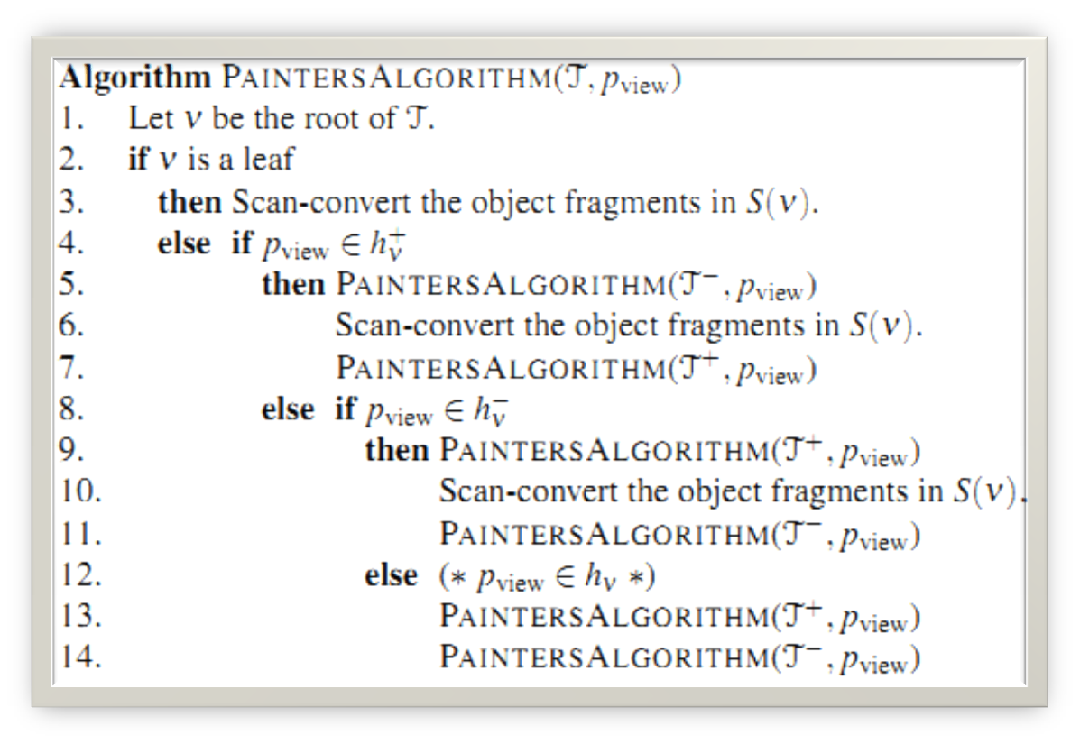
Painter’s Algorithm with BSP

Slide 11
Efficiency of Painter’s Algorithm
Depends largely on size of BSP Tree.
Splitting planes should minimize fragmentation of objects.
We would not consider oval shapes or curved surfaces.
Our model is polyhedral: Facets of Polyhedra have been triangulated.
Goal: BSP Trees of small size for given set of triangles in 3D.

Slide 12
Construction of BSP Tree
2D GENERALIZATION
3D IMPLEMENTATION

Slide 13
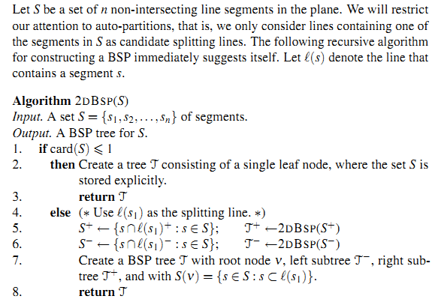
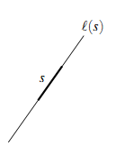
2D BSP Construction: Auto Partitioning

Slide 14
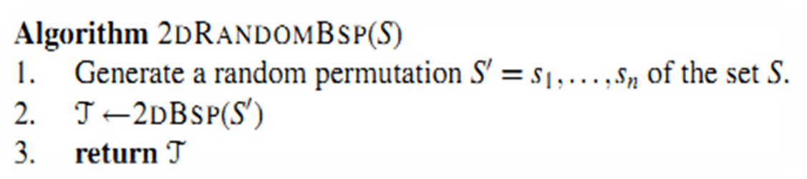
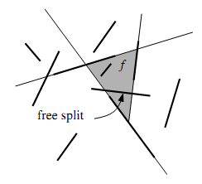
Analysis
Does the algorithm produce a small BSP tree?
  We do not know. ☹
  So, we will resort to randomness property.
Small Optimization: Free Splits.
  In ith step: choose a segment that cross a face
  completely.
  Advantage: No fragmentation of other lines,
  segment itself is not considered.

Slide 15
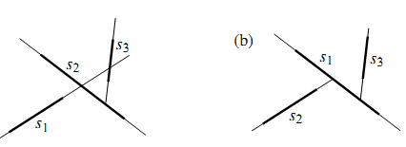
Analysis of 2DRandomBSP
Depends on permutation.
Lemma: The expected number of fragments generated by the algorithm 2DRANDOMBSP is O(nlogn).
Lemma: A BSP of size O(nlogn) can be computed in expected time O(n^2 logn).
Improvement: Segment trees (chapter 10). BSP of size O(nlogn) can be constructed in O(nlog n) time.

Slide 16
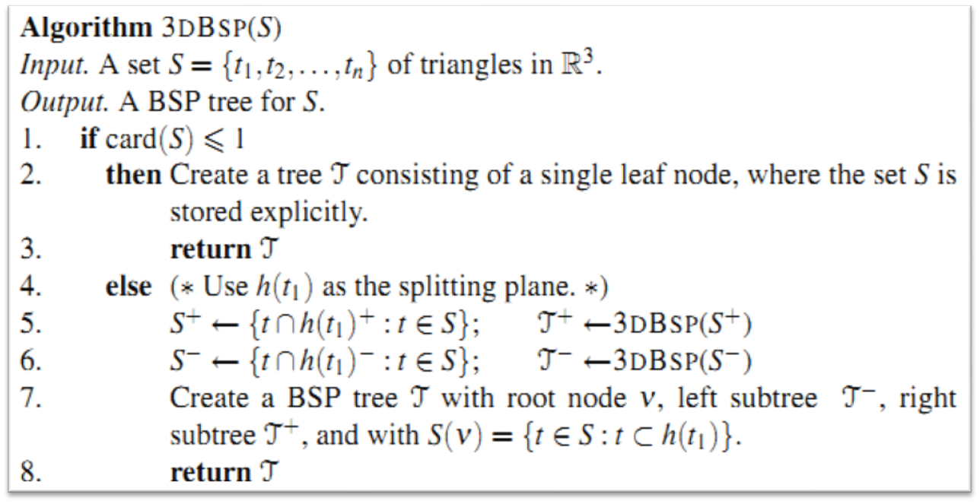
3D BSP Tree Construction
Similar to the 2D Case:

Slide 17
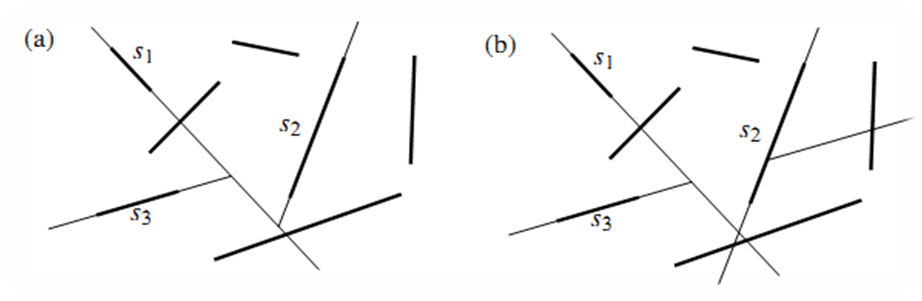
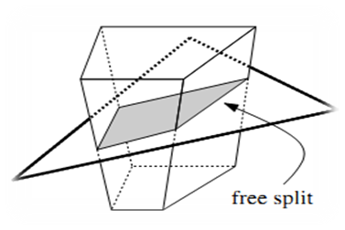
Improvement: Make Free Splits Maximally
A 2D Example:
Similarly we can extend this to 3D.

Slide 18
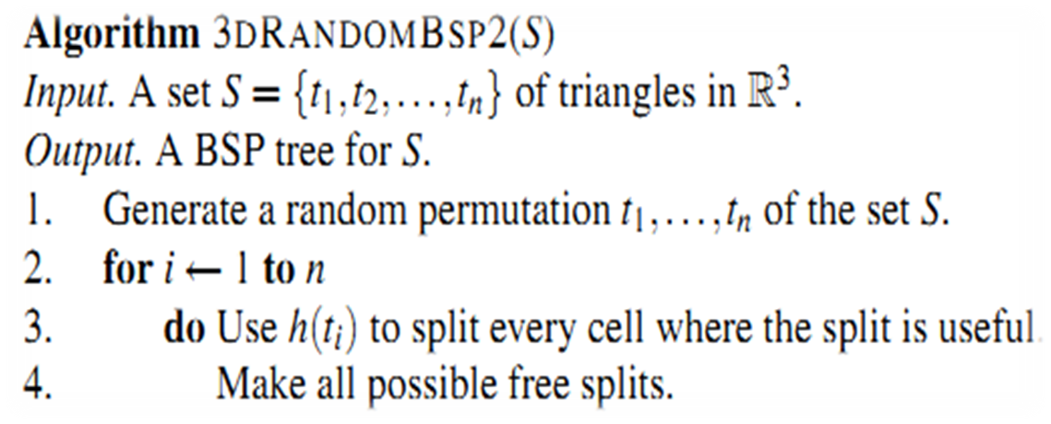
Improved Algorithm
E(object fragments generated over all n! permutations)= O(n2).
This result is disappointing for practical purposes.

Slide 19
Problem: Auto-partition
There are sets of n non-intersecting triangles in 3-space for which any auto-partition has size Ω(n2).

